Slide 1
Week-4
Session-2
●Management and Leadership
-Management and Leadership
- Levels of Management
-SWOT analysis
-Porter’s generic strategies
-Managerial skills
-Staffing, leadership, transparency etc.

Slide 2
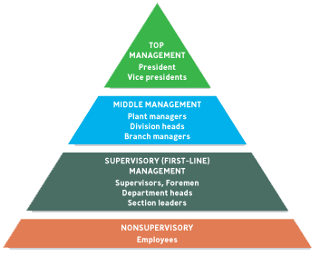
LEVELS of MANAGEMENT
*
Organizing: Creating a Unified System
*
LG4
7-

Slide 3

Formulating Business-Level Strategies
A number of frameworks have been developed for identifying the major strategic alternatives that organizations should consider when choosing their business-level strategies. Three important classification schemes are Porter’s generic strategies, the Miles and Snow typology, and strategies based on the product life cycle.

Slide 4
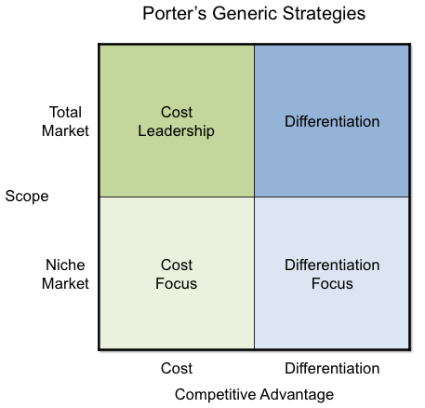
Porter’s Generic Strategies

Slide 5
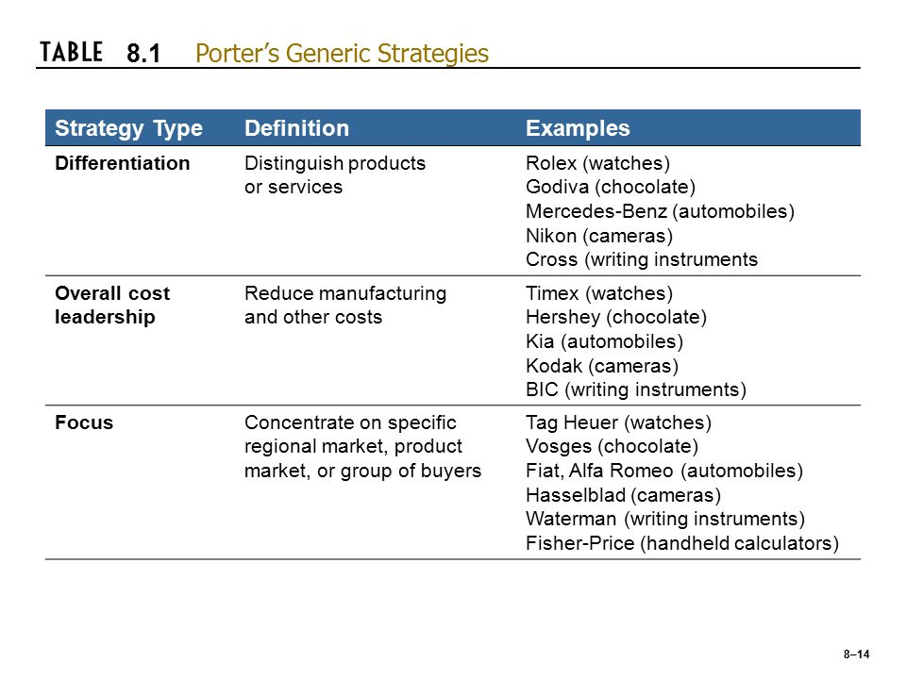
Porter’s Generic Strategies

Slide 6
Differentiation strategy
An organization that pursues a differentiation strategy seeks to distinguish itself from competitors through the quality (broadly defined) of its products or services. Firms that successfully implement a differentiation strategy are able to charge more than competitors because customers are willing to pay more to obtain the extra value they perceive.
Rolex pursues a differentiation strategy.
Rolex watches are handmade of precious metals like gold or platinum and stainless steel, and they are subjected to strenuous tests of quality and reliability. The firm’s reputation enables it to charge thousands of dollars for its watches

Slide 7
Overall Cost Leadership Strategy
Attempts to gain a competitive advantage by reducing its costs below the costs of competing firms. By keeping costs low, the organization is able to sell its products at low prices and still make a profit.
Timex uses an overall cost leadership strategy. For decades,. The price of Timex watches, starting around $39.95, is low because of the company’s efficient high volume manufacturing capacity

Slide 8
A Focus Strategy
concentrates on a specific regional market, product line, or group of buyers. This strategy may have either a differentiation focus, whereby the firm differentiates its products in the focus market, or an overall cost leadership focus, whereby the firm manufactures and sells its products at low cost in the focus market.
In the watch industry, Tag Heuer follows a focus differentiation strategy by selling only rugged waterproof watches to active consumers.
Fiat follows a focus cost leadership strategy by selling its automobiles only in Italy and in selected regions of Europe;
Alfa Romeo uses focus differentiation to sell its high-performance cars in these same markets.
Hasselblad makes expensive cameras targeted at professional photographers.
Fisher-Price uses focus differentiation to sell electronic calculators with large, brightly colored buttons to the parents of preschoolers;
stockbroker Edward Jones focuses on small-town settings.
General Mills focuses one part of its new-product development on consumers who eat meals while driving—their watchword is “Can we make it ‘one-handed’?” so that drivers can safely eat or drink it.

Slide 9
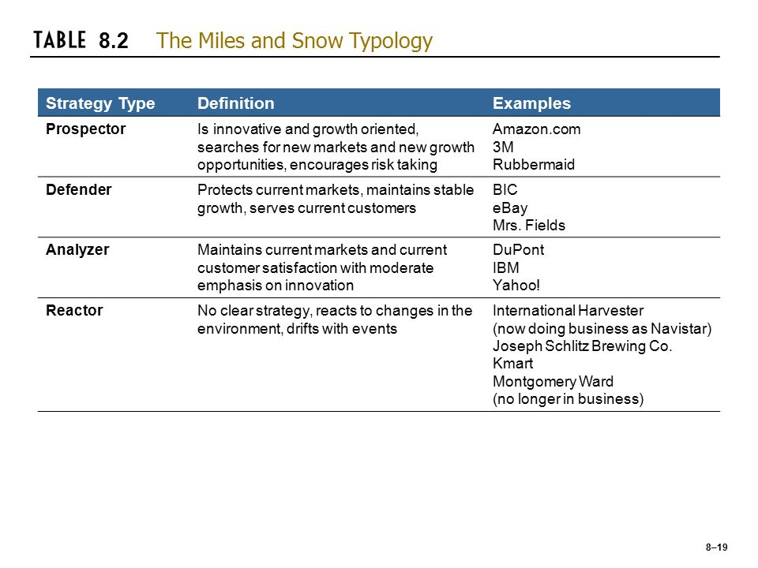
The Miles and Snow Typology

Slide 10
Organizing
After managers have planned a course of action, they must organize the firm to accomplish their goals. That means allocating resources, (such as funds for various departments), assigning tasks, establishing procedures.

Slide 11

Organizing
Skills/Tasks
  Technical- task in specific discipline
  Human relation- involve communication and motivation
  Conceptual- the ability to picture the org. as a whole
Staffing
  Involves recruiting, hiring, motivating and retaining the best people available to accomplish the company’s objectives.
7-

Slide 12
Leading
Leading involves communicating and directing employees to carry out the tasks and activities required to achieve the goals.

Slide 13
Controlling
The Control function measures performance relative to the planned objectives and standards, rewards people for work well done, and takes corrective action when necessary. Thus the control process (see Figure 7.8) provides the feedback that lets managers and workers adjust to deviations from plans and to changes in the environment that have affected performance. Controlling consist of five steps:

Slide 14
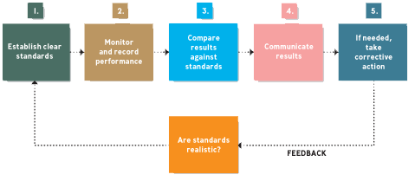
FIVE STEPS of CONTROLLING
*
Controlling: Making Sure it Works
*
LG6
7-

Slide 15
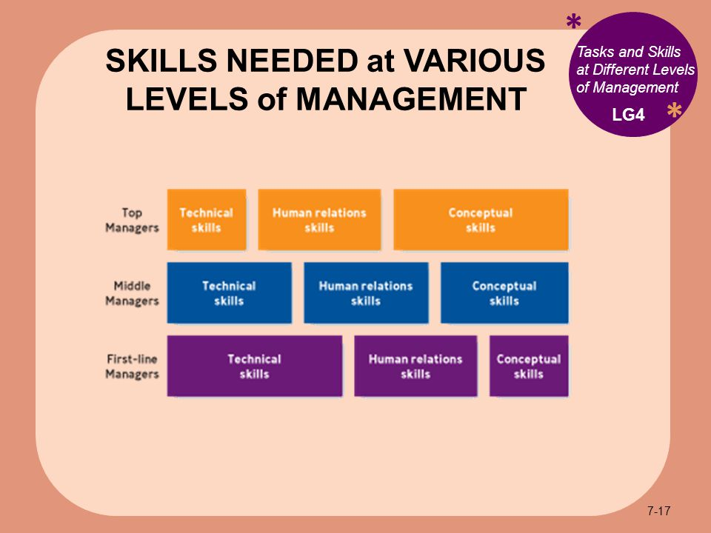

Slide 16
LEADERSHIP
*
Leading: Providing Continuous Vision and Values.
*
LG5
    Leaders must:
    Communicate a vision and rally others around that vision.
    Establish corporate values.
    Promote corporate ethics.
    Embrace change.
    Stress accountability and responsibility
7-

Slide 17
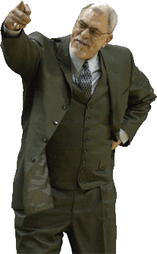
LEADERSHIP STYLES
*
Leadership Styles
    Autocratic Leadership -- Making managerial decisions without consulting others.
    Participative or Democratic Leadership -- Managers and employees work together to make decisions. flexibility, good listening skill, empathy
    Free-Rein Leadership -- Managers set objectives and employees are free to do whatever is appropriate to accomplish those objectives. Warmth, friendliness & understanding
*
LG5
7-
Notes:
mm

Slide 18
LEADERSHIP STYLES
Other concepts:
Directing
Empowerment
Enabling
Knowledge management

